Slide 1
Hand Building Coil Pottery
Studio in Ceramics
Mrs. Pountain

Slide 2
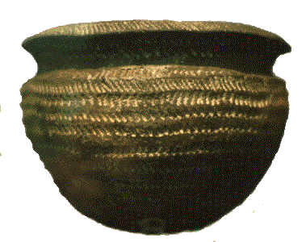
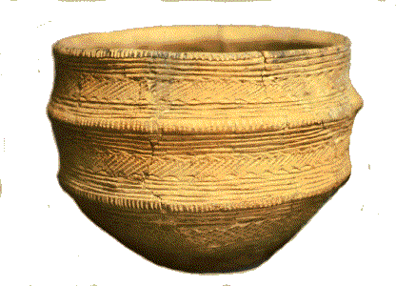
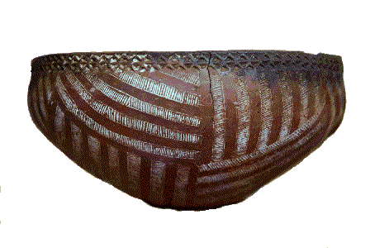
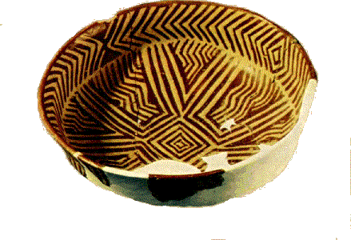
Prehistoric Britain
Prehistoric Britain
Prehistoric Egyptian 4000 B.C.
western Turkey c.5000 BC.

Slide 3
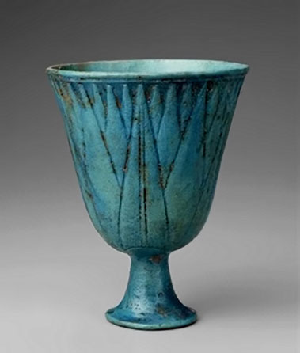
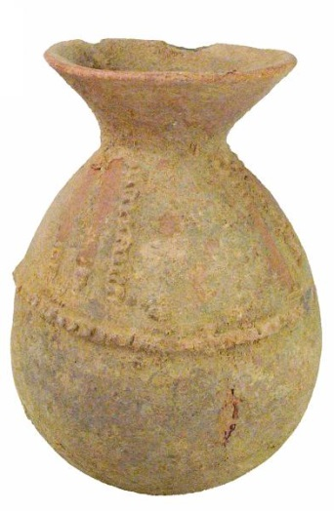
Egyptian Coil Pots

Slide 4
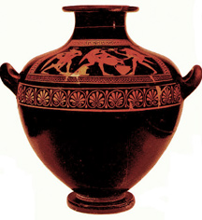
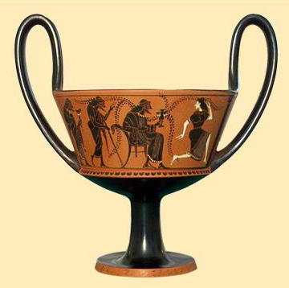
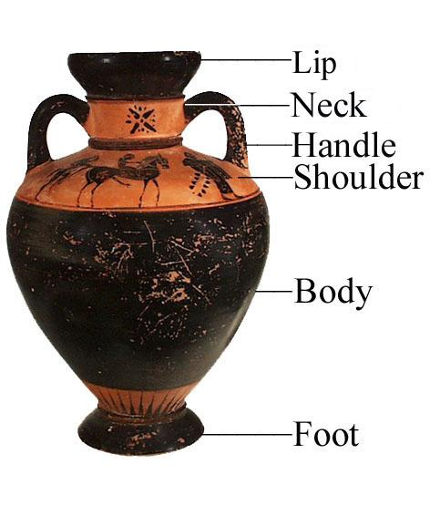
Greek Coil Pots

Slide 5
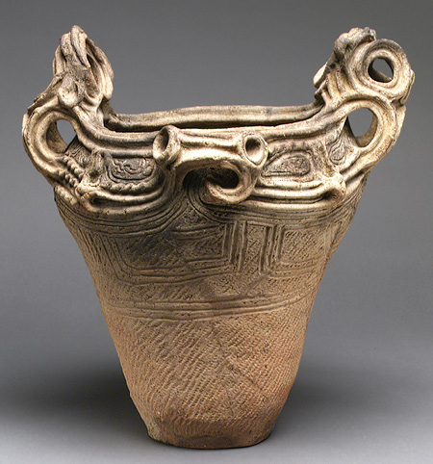
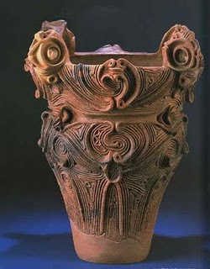
Chinese Coil Pots

Slide 6
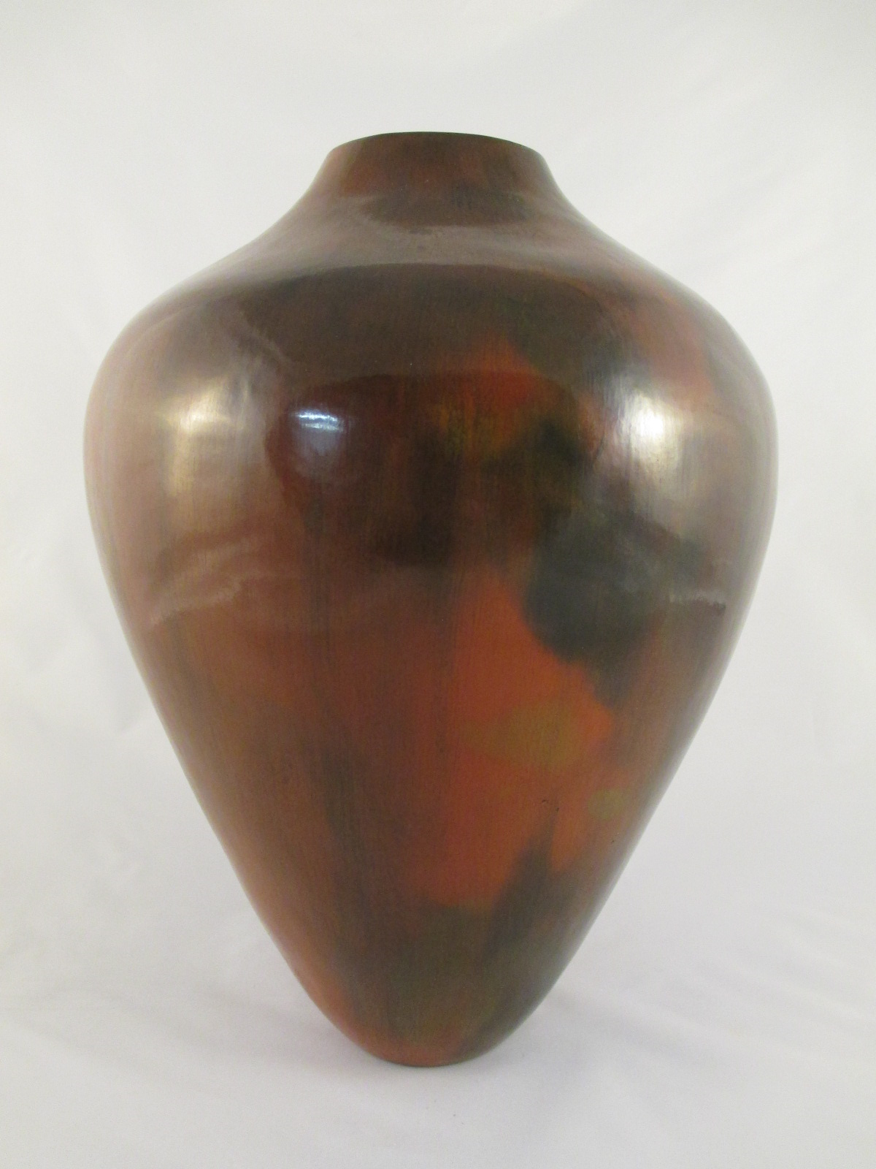
Navajo Coil Pots

Slide 7
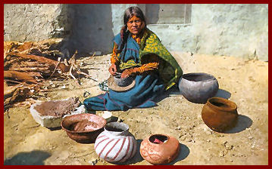
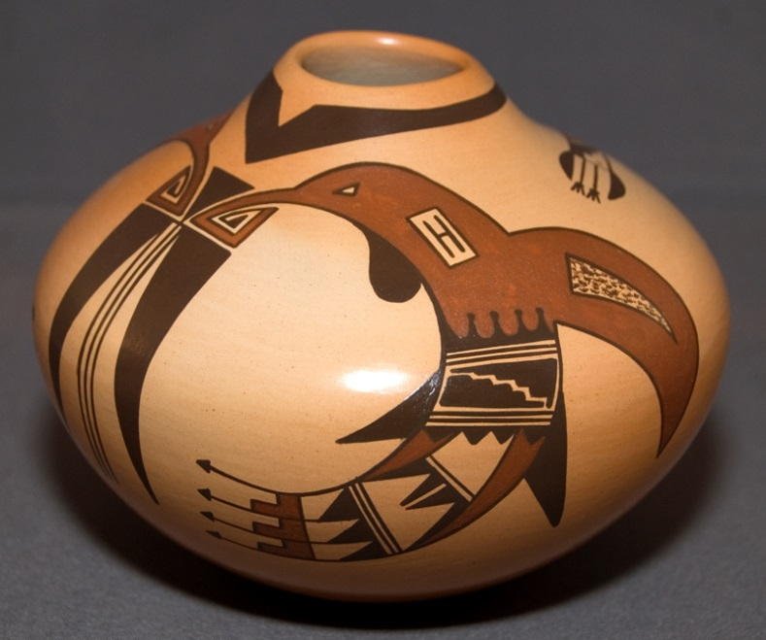
Hopi Coil Pots

Slide 8
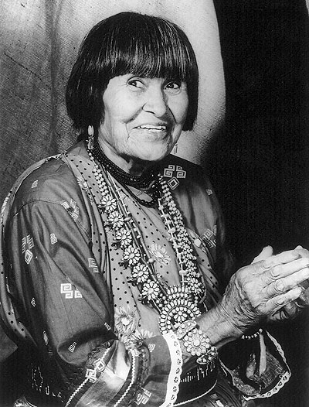
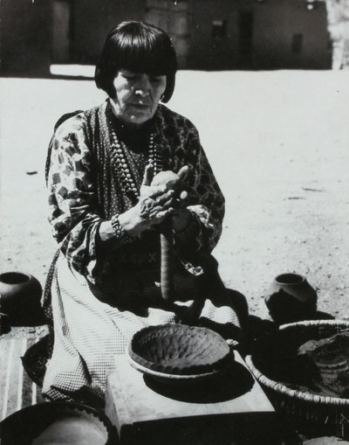
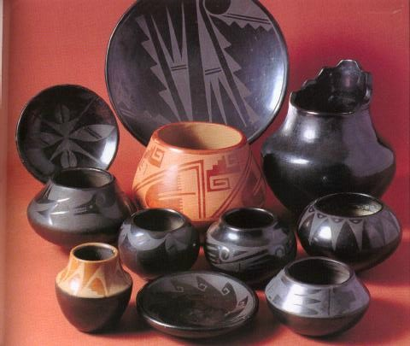
Maria Martinez – uses traditional Pueblo pottery styles and techniques to create pieces which reflect the Pueblo people’s legacy of fine artwork and crafts.
http://www.youtube.com/watch?v=7AhX1MhvAG8#t=98

Slide 9
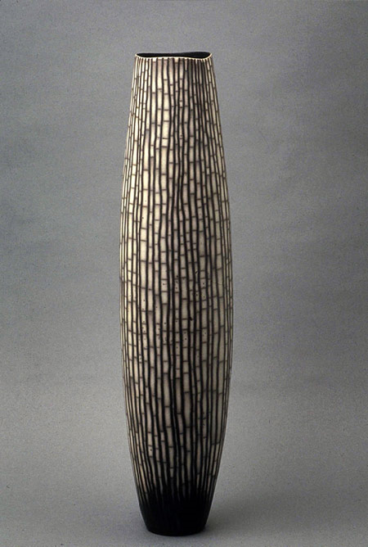
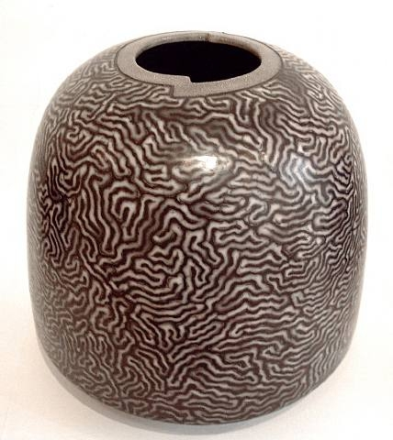
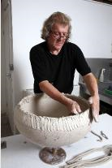
Contemporary Coil Artist David Roberts

Slide 10
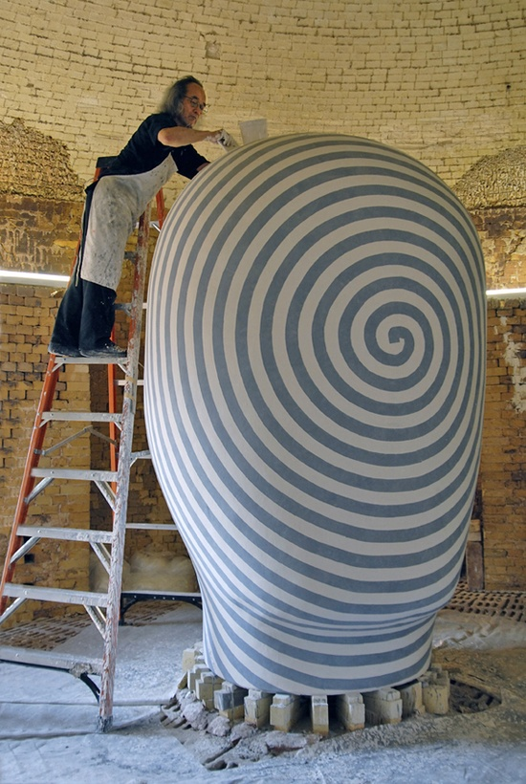
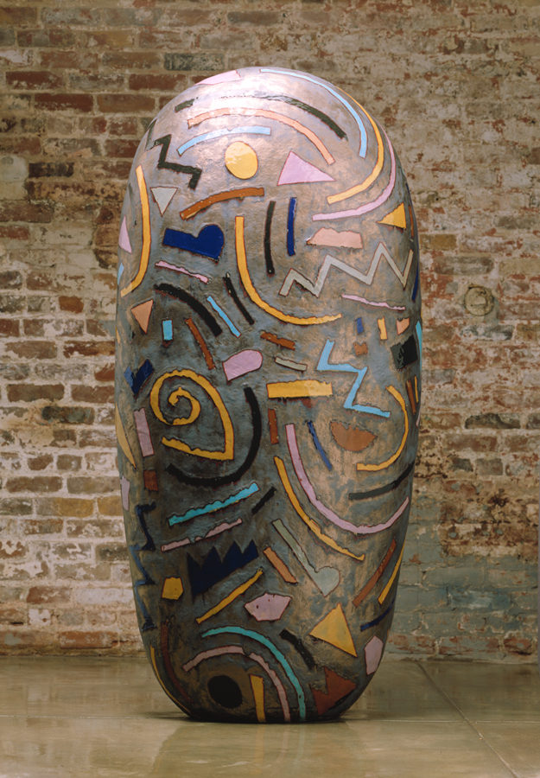
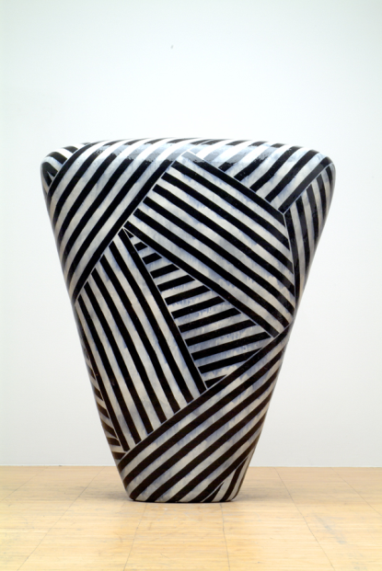
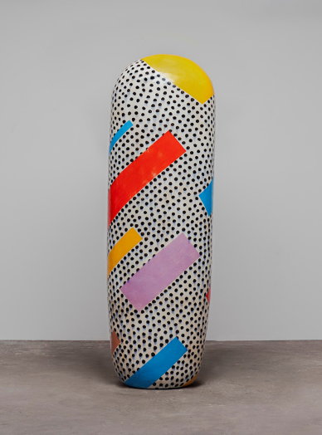
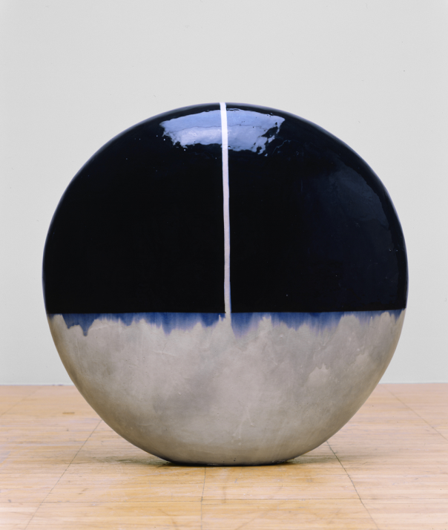
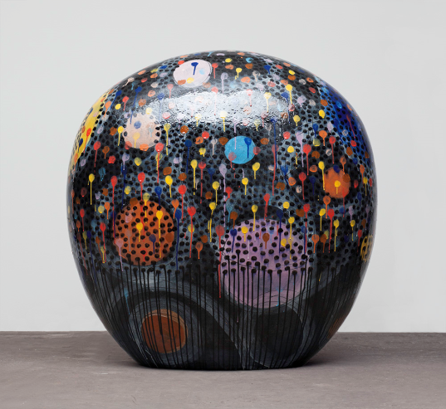
Jun Kaneko

Slide 11
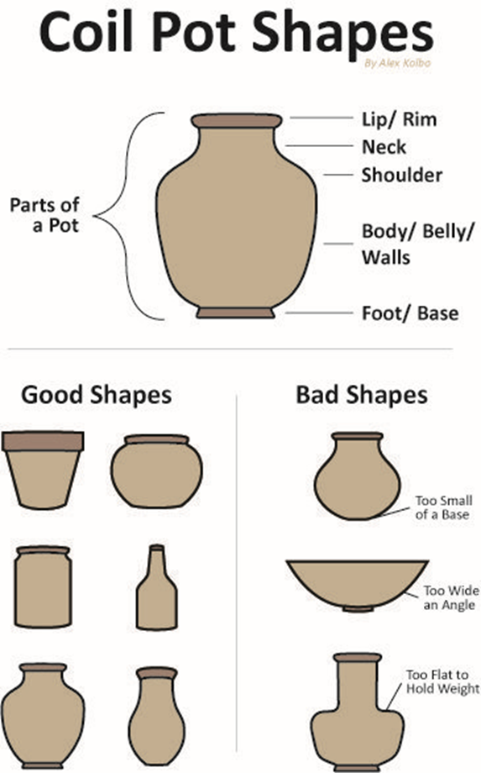

Slide 12
Assignment – Create a large pot using the coil method
Requirements:
Draw a definitive plan of action – With detail
Exact height needs to be listed with inches marked (where stuff “changes”)
Minimum Height 6 inches - Maximum Height 10 in.
Template – Use Cardboard or Oak tag
Creative Finish - Create pattern with texture (or sgraffito) or decoration with glaze/underglaze
Use a puki to get started
Handles and Spouts are optional – I will give information on how to do these later

Slide 13
